Slide 1
Building an app with React Native
in one month
Branislav Jenco
Sesam
Notes:
HI everyone!
Thank you all for coming to see my talk, I hope you enjoy it.
My name is Branislav and I work here at Sesam.
In this talk I am going to talk about how we built a cross platform mobile application using React Native a few months ago.
Feel free to ask me questions throughout or at the end.

Slide 2
Overview
What is React Native
Why we chose it for our app
Is it suitable for your project?
Notes:
I have three goals today.
First I want to explain to you what React Native is, how it works and how it fits into the ecosystem of mobile app development
Second I want to tell you a little bit about our application and why we chose React Native
And third my main goal is provide you insight that could help you when deciding on the technology to use for your next mobile development project.

Slide 3
About me
Working at Sesam since March
Front-end development
No experience with mobile development
Notes:
First a little about me, I've been working in the product team at Sesam since March as a front-end developer, I have about one and a half years of full time experience with web development and I had no experience with mobile development.

Slide 4
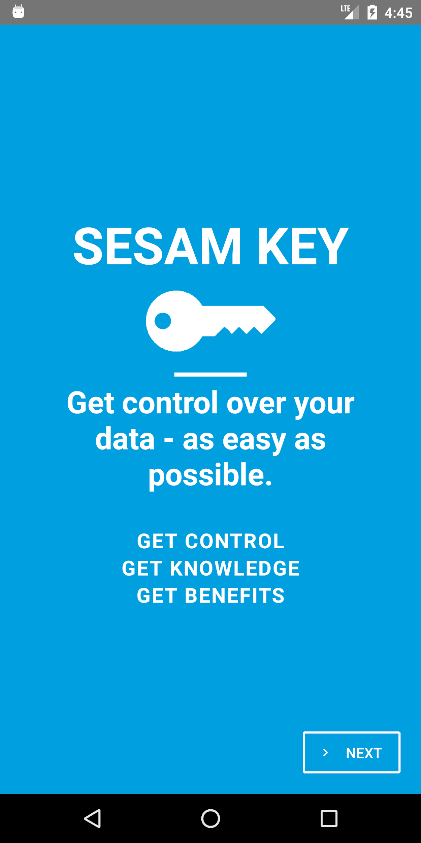
Sesam Key
Raise awareness of data privacy
Provide a useful tool
Both iOS and Android
Notes:
Sometime in April, we had an idea at Sesam to create a mobile app that would help us raise awareness of data privacy, ownership and protection to coincide with the introduction of the GDPR rules.

Slide 5
What it does
Scan user's email inbox
Create a list of companies
Send them a request email
Track communication
Notes:
Talk to user's email via IMAP and SMTP via OAuth2
Make a list of potential companies that have data on the user
Enable to send an email requesting data

Slide 6
Requirements
IMAP, SMTP
OAuth2
PGP key generation
Sesam Registry and Data Access Portal integration
Notes:
The app needs to be able to talk to the user's email inbox via IMAP and SMTP protocols. For the best user experience we don't want the user to type in all the imap connection data, so we want to support connecting via OAuth2. For talking with the Sesam Data Access portal we needed PGP key generation. And we had to talk via regular calls to some Sesam APIs.
We had about one month to do it and the amount of people for this was one, me, with some help along the way.

Slide 7
Options
Native
Xamarin
Flutter
PWA
PhoneGap (Cordova)
Ionic (Cordova)
Unity
React Native
Notes:
In the beginning, we had several choices of how we want to implement the application. Xamarin is a framework built on top of C#. Flutter is Google's attempt at making a cross platform mobile framework that they have been pushing hard for the past one and a half years. We could also make a straight up web app with progressive elements.
Ionic, PhoneGap use Apache Cordova which basically wraps webview components.
I've seen people use Unity for non-games mobile app development.

Slide 8
Options
Native
Xamarin
Flutter
PWA
PhoneGap (Cordova)
Ionic (Cordova)
Unity
React Native
Notes:
We could go the native route but it was important for us that the app ran on both iOS and Android and we don't have developers with experience in either within Sesam.
Flutter seemed like it was only pushed by Google and had still some growing pains, and not great support for iOS.
PWA didn't quite work because we wanted to store data on device. Unity is crazy to use outside of games.

Slide 9
Why we chose React Native
Experience with React
Ability to quickly prototype
Keep as much as possible on device
Develop on Linux/Mac/Windows
Learning experience
Notes:
The most important reason why we chose React Native was that we have experience using React in our web application. We could also use the same state management library namely Redux. We got the impression that we could quickly prototype using React Native than Xamarin, and we wanted to keep as much on device as possible. We thought we could do most development dev machine agnostic. Last but not least we thought it we be a good learning experience.

Slide 10

What it is and how it works

Slide 11
Open source framework for building cross-platform mobile applications with React
Facebook, Pinterest, Wix, AirBnb
Doesn't rely on WebViews
No DOM → Native UI libraries
Notes:
React Native is an open source framework for building crossplatform mobile applications using JavaScript and specifically React. React is a library for front-end user interface development written in Javascript

Slide 12
Threads
Main UI thread
Javascript thread (JSCore engine)
Other Native modules threads
UI stays responsive when JS thread does work

Slide 13
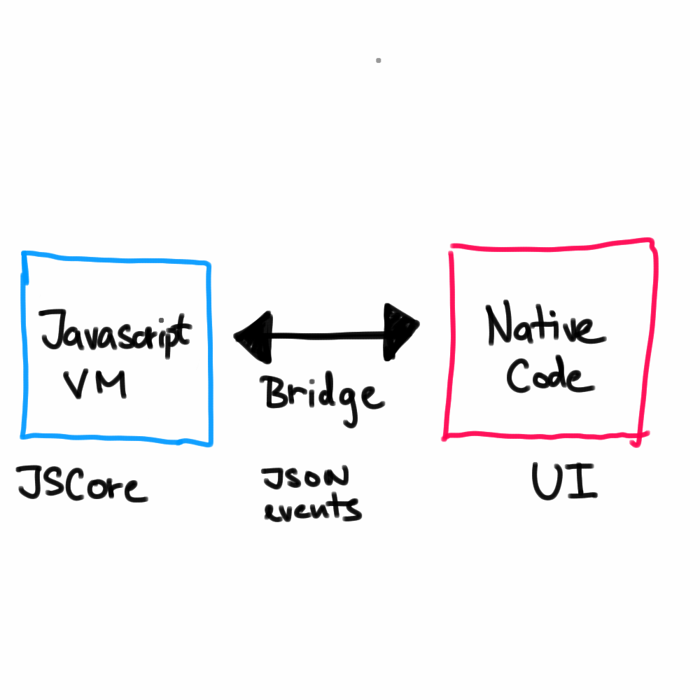
Asynchronous, batched, serialized events as JSON messages

Slide 14
I know React. Do I know React Native?

Slide 15
I know React. Do I know React Native?
Kind of.

Slide 16
Similarities
Same component architecture
JSX syntax
Class or functional components
Can use many familiar libraries
Lifecycle methods

Slide 17
<View style={[styles.container]}>
<TouchableOpacity onPress={this.handleClick}>
<Image source={require('./logo_white.png')}/>
</TouchableOpacity>
<Text style={{ fontSize: 30 }}>Some text</Text>
<Button onPress={this.handlePress}>Caption</Button>
</View>
Notes:
Your divs are view, your spans are text
You cannot put a view inside text tag (works only on iOS)
Familiar handlers

Slide 18
Plenty to learn
No CSS; styles behave slightly differently
iOS/Android idiosyncrasies
Native modules interoperability
Building, deployment, testing process
Notes:
There is no CSS, you control the styling of your components through Stylesheet objects that are very similar to CSS but with some notable differences. Flexbox for layout.
You will come across things which work only on Android or only on iOS.
You will need to learn how to talk with native modules
You will need to figure out your build/deployment and testing process
All these are actually no small tasks and especially the last one

Slide 19
Building and deployment
GitHub → Nevercode → App Store/Play Store
Notes:
We host the repository on GitHub, pull requests get picked up by Nevercode, which we set up with help from folks from Bouvet. Johannes Lagos and Christian Aamodt
Nevercode takes care of signing the resulting binaries and pushes the to the AppStore and Play Store.

Slide 20
Our experience

Slide 21
Upsides
Familiar for React developers
Redux or other state management libraries
Create React Native App
Very simple layout and styling
Animation control

Slide 22
Downsides
Evolving
Need to dive into native code
Polyfilling Node libraries
No single navigation solution
Still need a Mac
Expo confusion

Slide 23
Conclusion
Not a silver bullet
Knowing React helps
The right tool for the right job

Slide 24
Thank you!

